Slide 1

John Reinhard Weguelin
(1849-1927)英

Slide 2
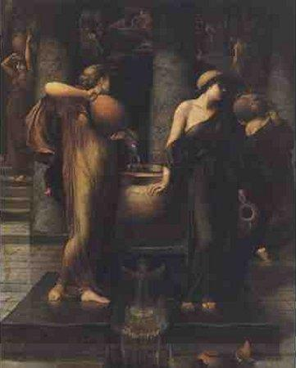
Notes:
The Labour of the Danaïdes (1878)

Slide 3

Notes:
Lesbia (1878),

Slide 4
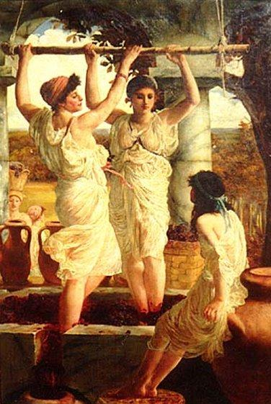
Notes:
Pressing Grapes (1880).

Slide 5
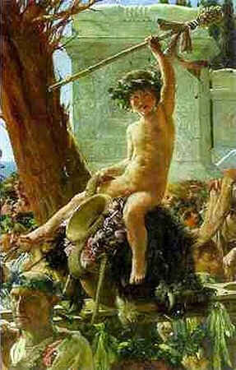
Notes:
Bacchus Triumphant (1882).

Slide 6


Slide 7
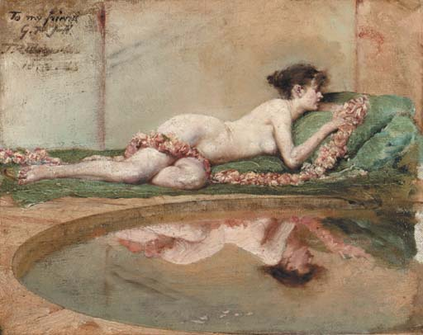
Notes:
Reflection (1885).

Slide 8
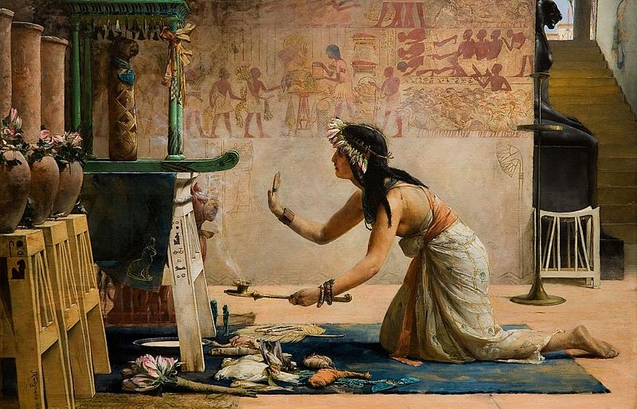
Notes:
The Obsequies of an Egyptian Cat (1886)

Slide 9
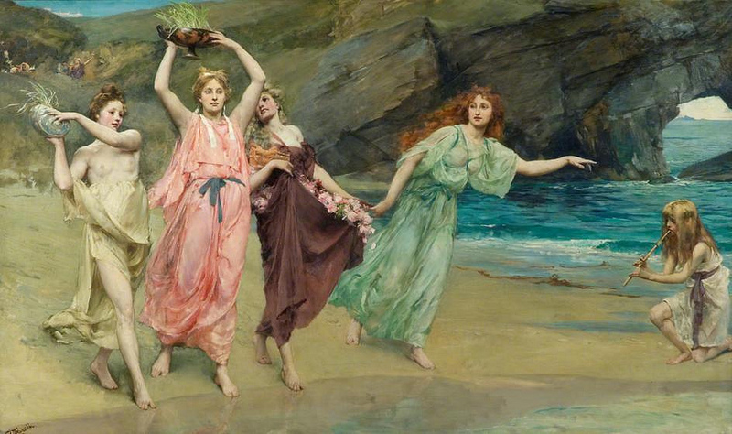
Notes:
The Gardens of Adonis (1888).

Slide 10
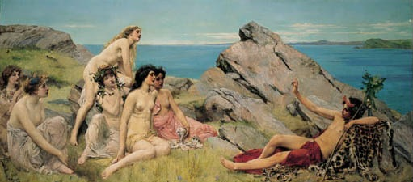
Notes:
Bacchus and the Choir of Nymphs (1888)

Slide 11

Notes:
The Bath (1890).

Slide 12
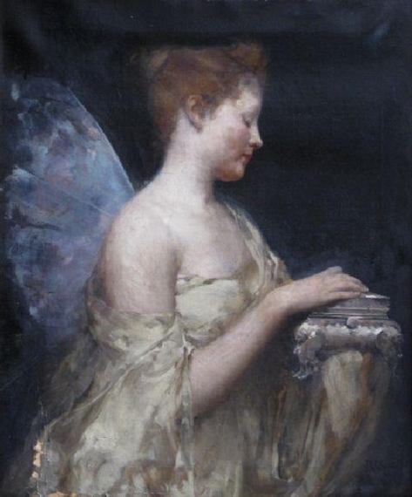
Notes:
Psyche (1890).

Slide 13
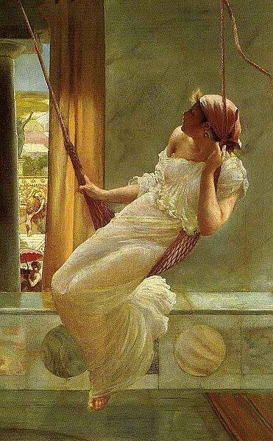
Notes:
The Swing (1893)

Slide 14
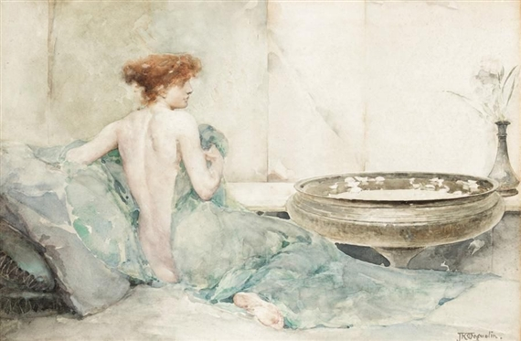
Notes:
Rodantha 1894

Slide 15
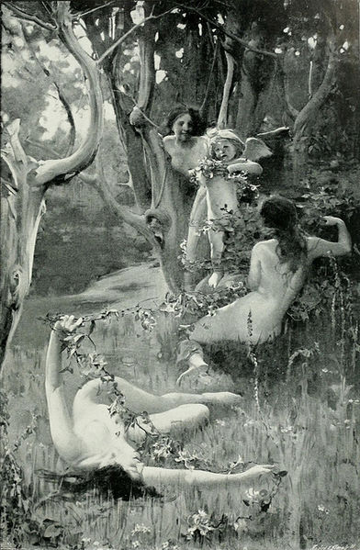
Notes:
Cupid Bound by the Nymphs (1896)

Slide 16
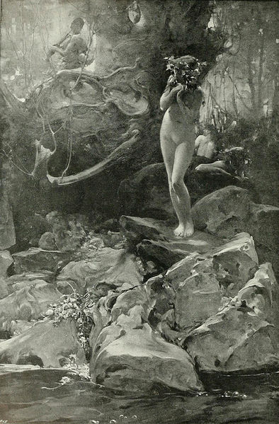
Notes:
The Piper and the Nymphs (1897).

Slide 17
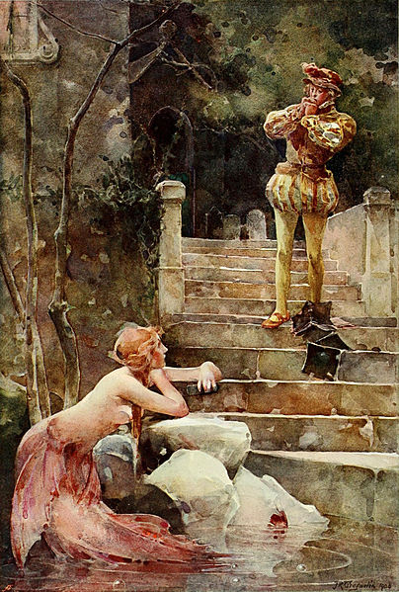
Notes:
The Mermaid of Zennor 1900

Slide 18
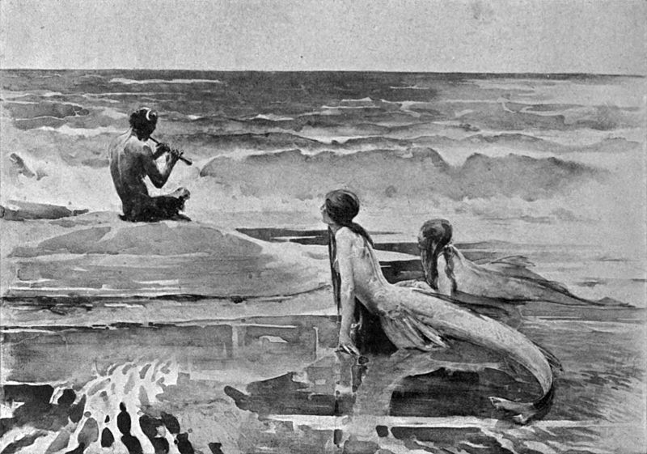
Notes:
Pan the Beguiler (1898)

Slide 19
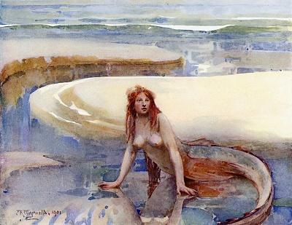
Notes:
The Rainbow Lies in the Curve of the Sand (1901)

Slide 20

Notes:
Mermaid (1911).

Slide 21
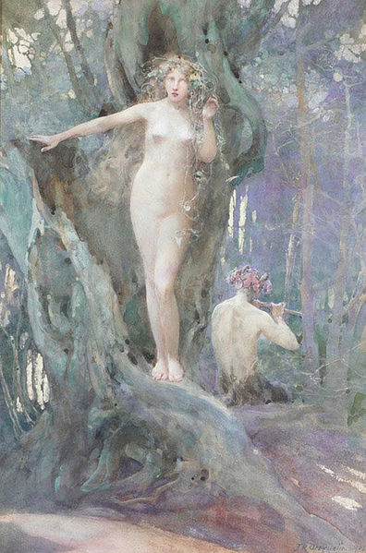
Notes:
The Magic of Pan's Flute (1905).

Slide 22
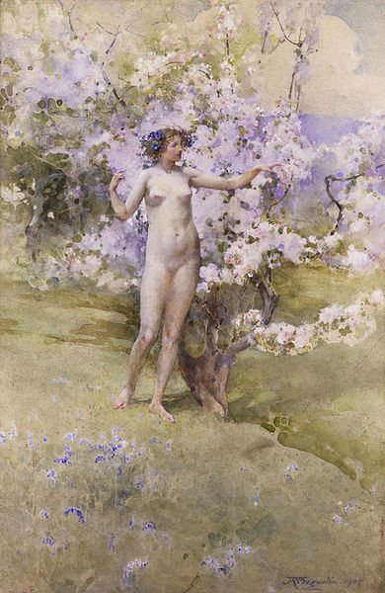
Notes:
Cherry Blossom (1905).

Slide 23
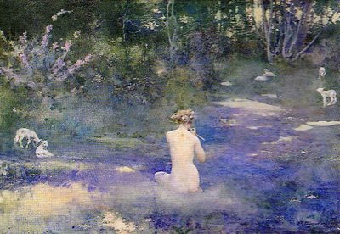
Notes:
A Pastoral (1905).

Slide 24
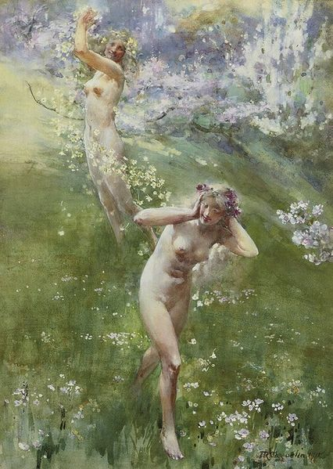
Notes:
Gladsome Spring (1911).

Slide 25
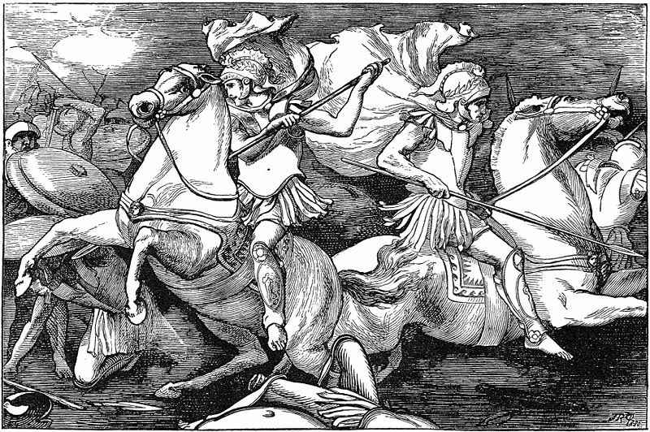
Notes:
Castor and Pollux, from Lays of Ancient Rome (1881)

Slide 26
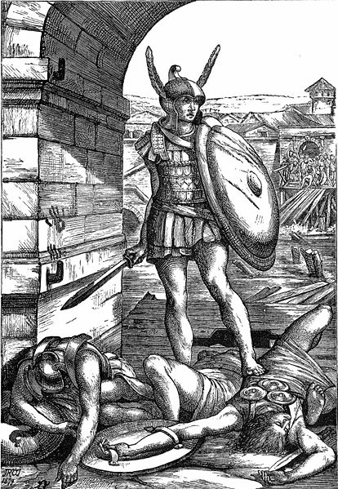
Notes:
Horatius, from Lays of Ancient Rome (1881)

